Slide 1
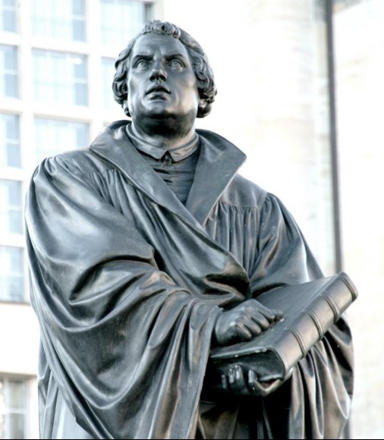
Why do you call yourself Lutheran?
Martin Luther, A.D. 1483-1546

Slide 2
Let’s look first at a hymn written in 1527, when thousands were hearing the words of Scripture from Martin Luther. An unknown German author captured in one verse the story of the Reformation.
O God, our Lord, Thy holy Word
Was long a hidden treasure
Till to its place It was by grace
Restored in fullest measure.
For this today
Our thanks we say
And gladly glorify Thee.
Thy mercy show
And grace bestow
On all who still deny Thee.
TLH #266

Slide 3
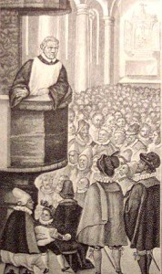
Martin Luther is one of the most influential figures in the history of Christianity.
1500 years after the time of the apostles, God used his servant, Luther, to bring His Word, again, for the common man’s use by translating God’s Word into the language of the German people.

Slide 4
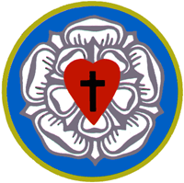
How blest we are to be his heirs!
In 2017 the church celebrated the 500th anniversary of Luther’s posting of his 95 Theses. We want to thank God for restoring the true teachings of the Bible.

Slide 5
Let us go way back in history to understand why the world needed a reformer like Martin Luther
Where did this happen?
When did it happen?
How did it happen?

Slide 6
Where did this happen?

Slide 7
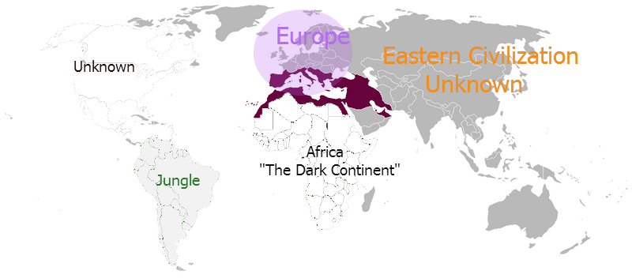
Every world event in early Christian history happened around the Mediterranean Sea, the “Cradle of Western Civilization.”
Mediterranean Sea

Slide 8
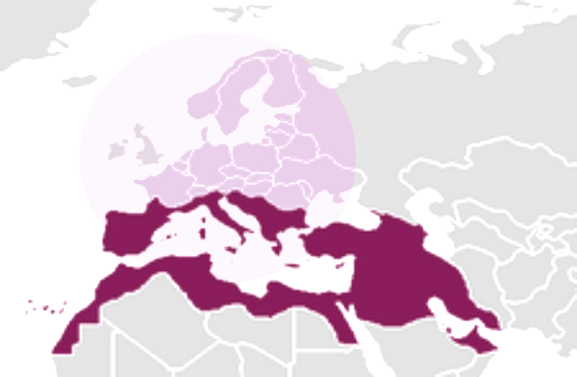
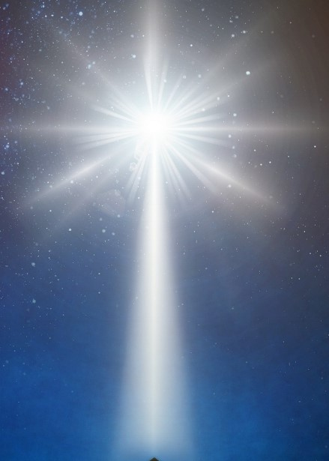
The dark purple area is the Roman Empire, which ruled the world during the time of Christ’s ministry.
This is the “cradle” of Christianity.
Mediterranean Sea
Jesus was born in Bethlehem (Israel) at the beginning of the New Testament
Notes:
edit

Slide 9
The rest of the continent of Europe lies directly to the north of the Roman Empire.
Europe
Germany
Israel Land of Jesus
Northern Europe is where the Lutheran Reformation began.

Slide 10
On a world map “Western” culture came from this region -- the “Cradle of Western Civilization.” Can you see why the Roman roads were critical?
Mediterranean Sea

Slide 11
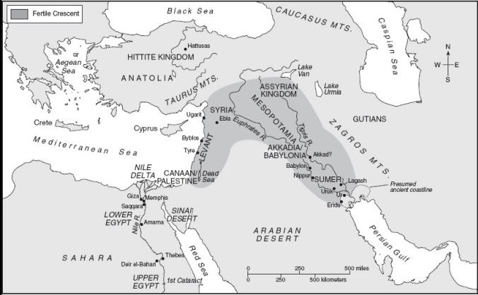
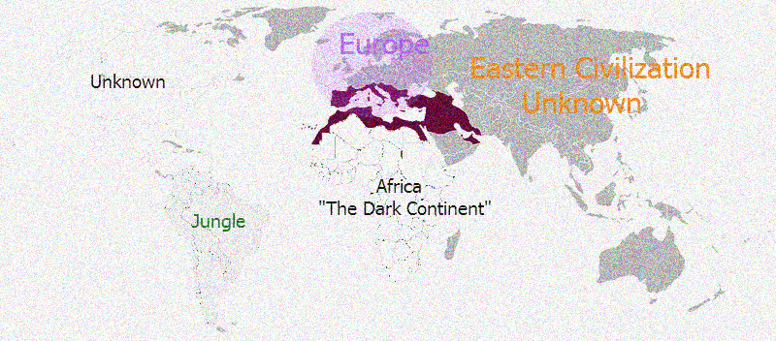
Early in Genesis, after leaving the Ark, Noah and his family would have encountered the present-day Tigris and Euphrates Rivers, east of the Mediterranean Sea, in Ancient Mesopotamia.
Mediterranean Sea
[1]
Notes:
Map 1.1 "The Ancient Near East, 4000-1000 B.C.E.“ http://web.cocc.edu/cagatucci/classes/hum213/Maps/Maps2HistoryAncient.htm

Slide 12
From Ancient Mesopotamia we gain the use of our base 10 numbers.
Mesopotamia
Mediterranean Sea
This is where great men of faith like Noah, Abraham, Isaac, Jacob (Israel), and Daniel waited for their Savior.
[7]

Slide 13

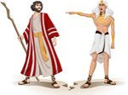
Ancient Egyptians were the first to write words instead of pictures.
Mesopotamia
Mediterranean Sea
Egypt
God used Moses to take the children of Israel out of Egyptian slavery as recorded in the book of Exodus.

Slide 14
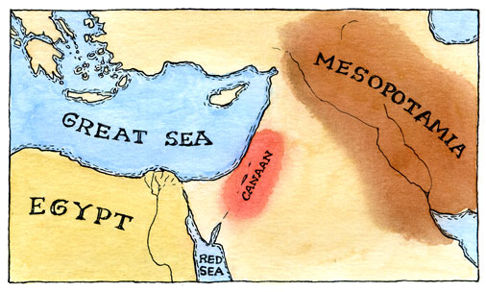

Ancient Israel arose when God called Abraham out of Mesopotamia to the land of Canaan. Abraham’s descendants were the Israelites, God’s chosen people.
[2]
Mediterranean Sea
Later called Israel when God renamed Jacob
Moved by the Holy Spirit, Moses wrote the first five books of the Old Testament.

Slide 15


Ancient Greece ruled the world after the Old Testament was finished. We use their idea of Democracy.
Greek Empire
Mesopotamia
Egypt
Israel
Mediterranean Sea
Koine Greek (or Common Greek) was chosen by God as the language in which every book of the New Testament was written.

Slide 16

Finally the Roman Empire conquered all of the region. Our Senate came from them.
Greek Empire
Roman Empire
Mesopotamia
Egypt
Israel
Mediterranean Sea
The 27 books of the New Testament were written during the time of the Roman Empire.

Slide 17
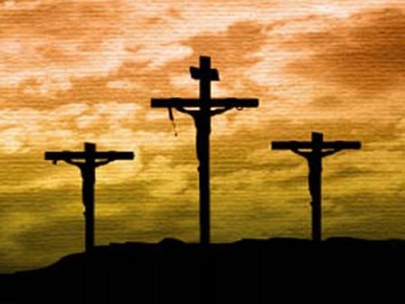
Jesus was born in Israel, when it was governed by the Roman Empire.
4000 B.C.
2000 B.C.
A.D. 0
Today
Roman Empire
753 B.C. - A.D. 476
Galatians 4:4 “But when the fullness of the time had come, God sent forth His Son…………..”

Slide 18

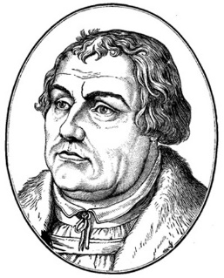
Martin Luther was born in Germany in A.D. 1483.
4000 B.C.
2000 B.C.
A.D 0
A.D 1500
[9]

Slide 19

Notice how close Germany is to the birthplace of Jesus and to the capital city of Rome.
Germany Land of Luther
Israel Land of Jesus
Rome, Italy

Slide 20
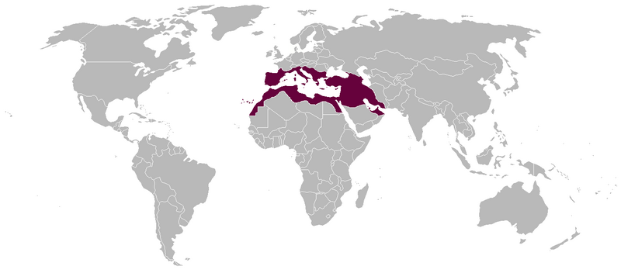

European Lutherans brought their Christian faith from the Old World
To the NEW World
The watchwords of the Reformation were Salvation….
By Scripture alone
By Faith alone
By Grace alone
[3]

Slide 21
When did this happen?

Slide 22
This is a picture of recorded history on a line covering 6,000 years.
4000 B.C.
2000 B.C.
A.D 0
You are here
Today 2024
Creation
The Great Flood
Jesus
Adam and Eve
Noah
[6]

Slide 23



This is where the five great Western Civilizations fall on this line.
Ancient Mesopotamia 4000-333 B.C.
Ancient Greece 800 - 146 B.C.
4000 B.C.
2000 B.C.
A.D 0
Today
Ancient Egypt 3081-30 B.C.
Rome 753 B.C. – A.D 476
Ancient Israel 1700 B.C. – A.D 70
Creation
The Great Flood
Jesus
Adam and Eve
Noah
[10]
[8]

Slide 24
This shows when the Patriarchs were born.
Ancient Mesopotamia 4000 – 333 B.C.
Ancient Greece 800-146 B.C.
A.D 0
Today
4000 B.C.
2000 B.C.
Ancient Egypt 3081-30 B.C.
Adam b.-4000
Noah b.-2913
Abraham b.-1996
Moses b.-1589
Rome 753 B.C. - A.D. 476
Ancient Israel 1700 B.C. – A.D. 70
Creation
The Great Flood
Jesus
He raised Him from the dead and seated Him at His right hand in the heavenly places, far above all rule and authority and power and dominion... Eph. 1:20
Adam and Eve
Noah
[6]

Slide 25
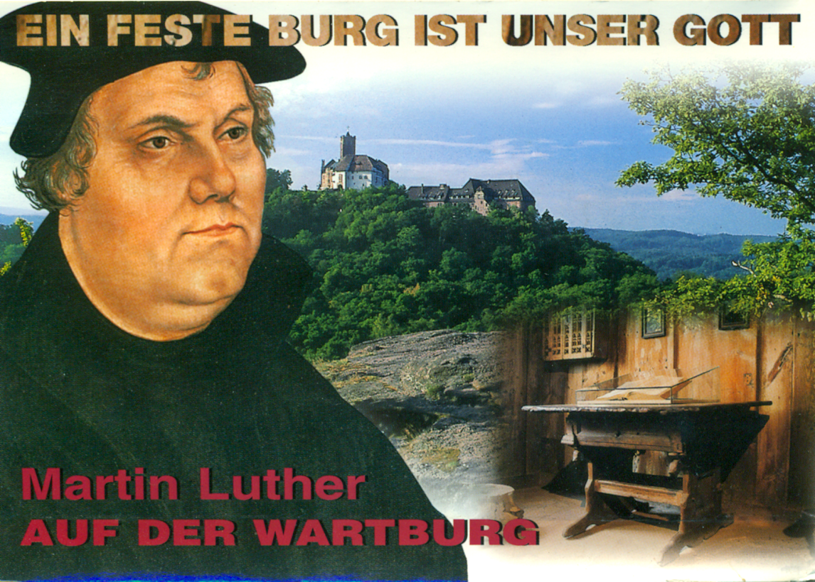
“A Mighty Fortress is our God”
Today
A.D. 2017
4000 B.C.
2000 B.C.
A.D. 0
500 | 500 | 500 | 500 | 500 | 500 | 500 | 500 | 500 | 500 | 500 | 500
b. 1483
Luther was born during the Renaissance and was a contemporary of such notable people as Gutenberg, Michelangelo, Copernicus, Columbus, and Queen Elizabeth I. [10]
[4]

Slide 26
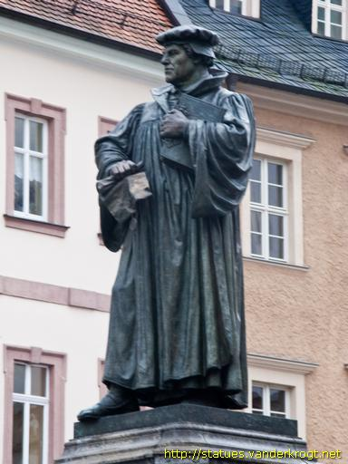
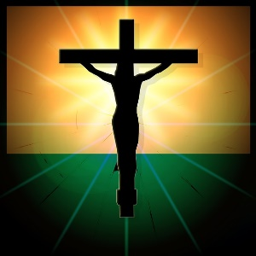
Anno Domini “In the year of the Lord “= A.D.
Before Christ = B.C.
4000 B.C.
2000 B.C.
A.D. 33
Today
A.D. 2017
---500--- | ---500 | 500 | ---500--- | ---500--- | ---500 | 500 | ---500--- | ---500--- | 50 | 500--- | ---500---
Spans 2000 years
Spans 2000 years
Spans 2000 years
born 1 B.C.
born A.D. 1483
On our world history timeline Luther is closer to our time, 1500 years AFTER Christ.
[11]

Slide 27
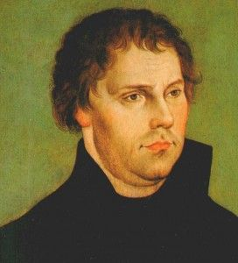
4000 B.C.
2000 B.C.
A.D. 0
Today
 |  |  |  |  |  |  |  |  |  |  | 500 yrs.
“He Is Coming………………………………………………...…”
“He Came……..”
Old Testament period
New Testament period
Martin Luther was born well after the completion of the Holy Scriptures. The Revelation of St. John, the last book of the Bible, was written in A.D. 95.
[5]

Slide 28

The Gospel spread throughout the known world during the era known as the Pax Romana (Peace of Rome).
Today
The Pax Romana
Dark Ages
 |  |  |  |  |  |  |  |  | 500 | 500
But it became hidden during the Dark Ages.
Let’s take a look at what happened.
12

Slide 29
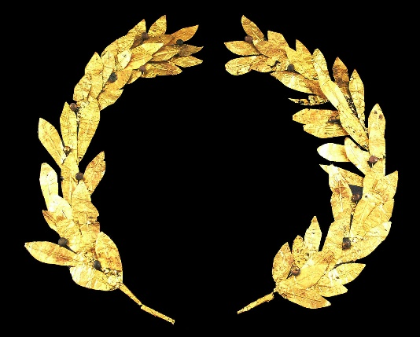
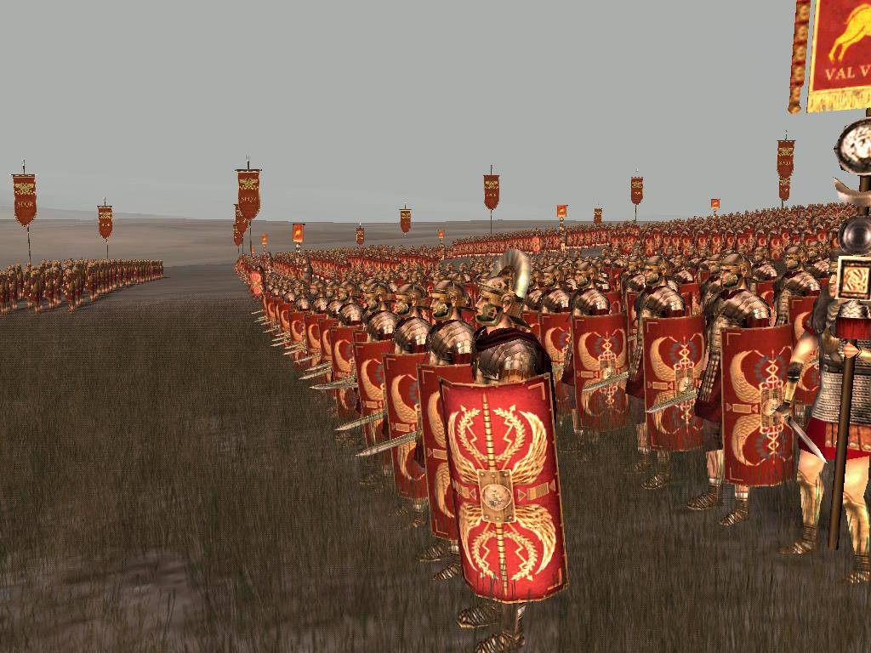
Pax Romana began 275 years before Christ, when Caesar sent his Roman Legions out to conquer every country, all the way to the edge of the Chinese Empire.
13
Notes:
http://www.twcenter.net/forums/showthread.php?698253-Research-thread-Imperial-Roman-Army

Slide 30
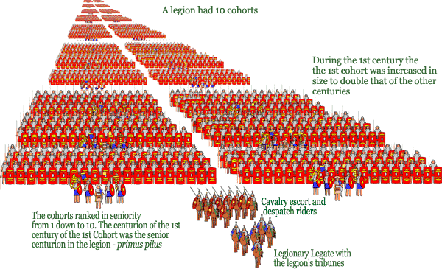
Mighty Roman Legions marched throughout the empire. No one could beat them. They constructed mighty fortresses perfectly positioned at strategic crossroads built throughout the empire.
14

Slide 31
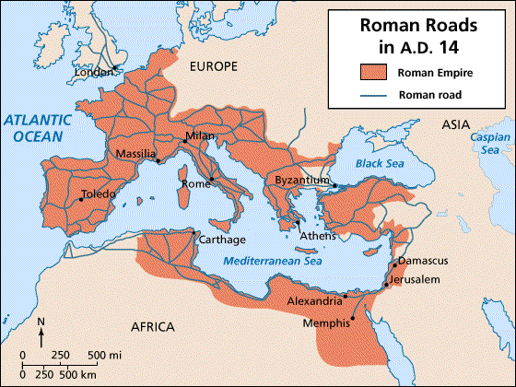


These 50,000 miles of roads allowed troops to be quickly moved to where they were most needed. They also allowed the movement of people and goods. In that way they helped Christians spread the Good News of the Gospel of Jesus everywhere.
17

Slide 32
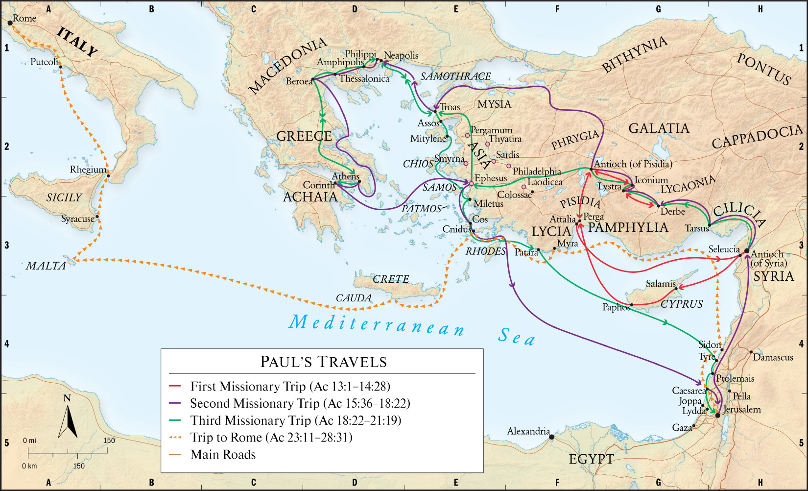

1500 years before Luther, the first Christian pastors, the Apostle Paul and other evangelists, traveled throughout the Empire on those safe roads, spreading the Good News, establishing and then strengthening all the new Christian congregations in the empire.
18

Slide 33
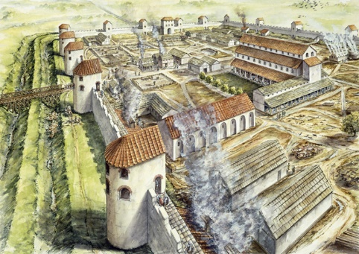
Roman fortresses sat at every crossroad and were impregnable. The Roman Legions used their roads to travel throughout the Empire from one fortress to the next, keeping order in the land.
15

Slide 34
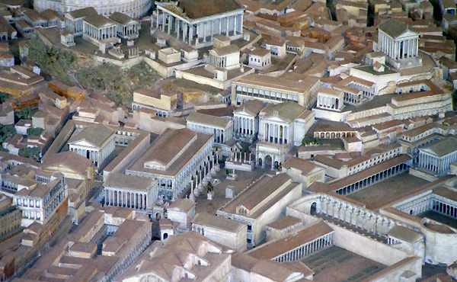
Their capital city, Rome, was a glittering forest of marble pillars and steps. Spectacular temples rose skyward, triumphal arches welcomed the Legions. Large, free-standing columns commemorated great victories of the past.
16

Slide 36
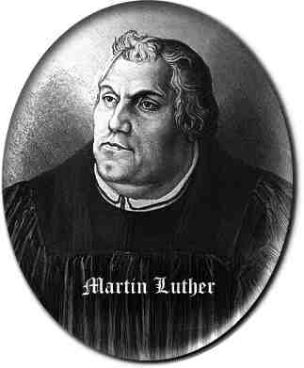
But the mighty power of the Roman Empire collapsed when it was finally invaded by foreign barbarians.
Ancient Mesopotamia 4000-333 B.C.
Ancient Greece 800-146 B.C.
4000 B.C.
2000 B.C.
A.D. 0
Today
Ancient Egypt 3081-30 B.C.
Rome 753 B.C. –A.D 476
Ancient Israel 1700 B.C.- A.D. 70
The Dark Ages
Creation
The Great Flood
Jesus

Slide 37
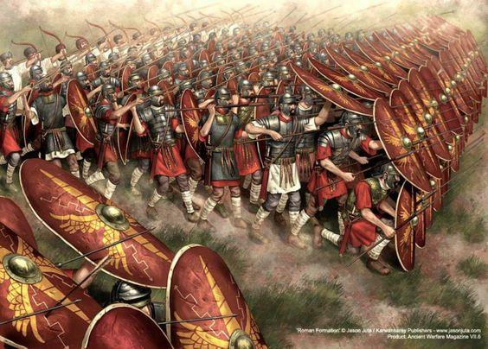
One reason for the collapse: The discipline of the fighting forces gradually disintegrated.
[19]

Slide 38
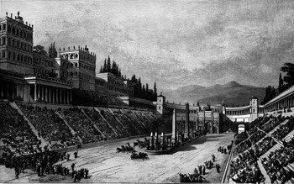
Another reason was that the people turned all their attention to games at the Circus Maximus.
[20]

Slide 39
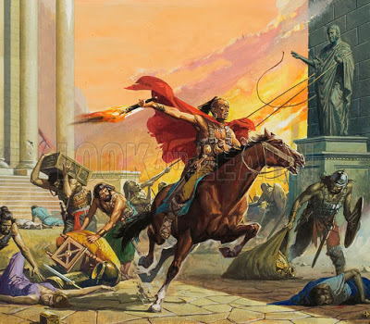
In A.D. 476 Rome was overthrown by the Germanic leader Odoacer, who became the first Barbarian to rule in Rome. The order that the Roman Empire had brought to Western Europe for 1000 years was no more.
[21]

Slide 40
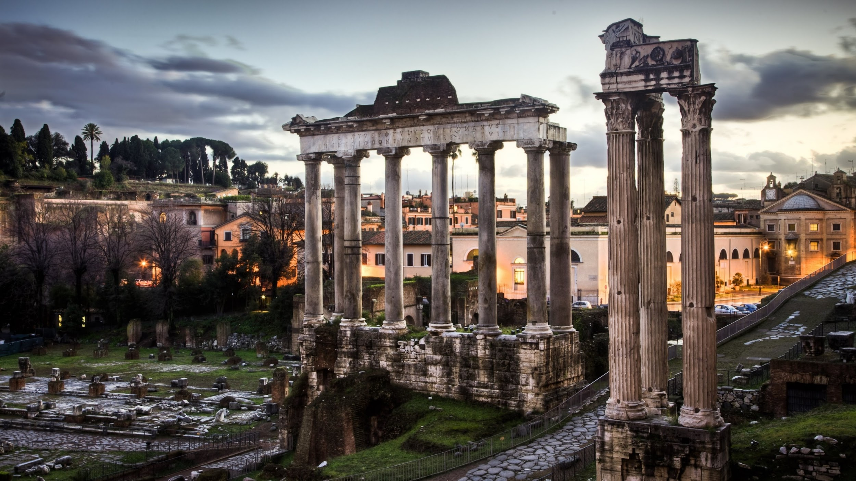
The Roman Forum today.
[22]

Slide 41
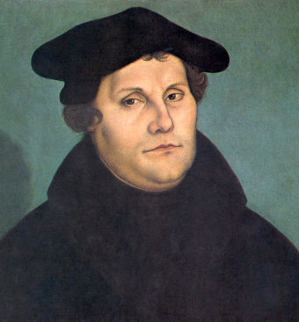
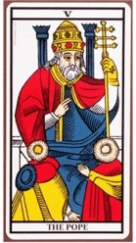
After the Roman Empire was conquered by barbarian kingdoms, Europe grew weak and the Roman Catholic church became very wealthy and powerful. No central government would grow to have dominion.
Ancient Mesopotamia 4000-333 B.C.
4000 B.C.
2000 B.C.
Ancient Greece 800-146 B.C.
A.D 0
Today
Ancient Egypt 3081-30 B.C.
Rome 753 B.C. – A.D 476
Ancient Israel 1700 B.C. – A.D. 70
The Dark Ages
Creation
The Great Flood
Jesus

Slide 42
How did this happen?

Slide 43
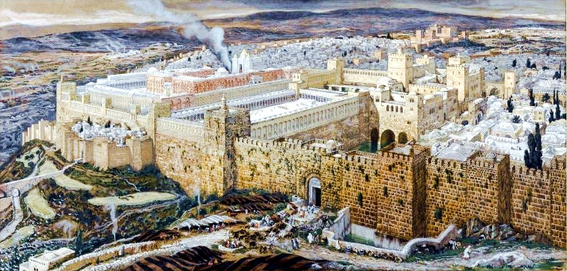
We begin in Jerusalem – at the time of Christ.
[23]

Slide 44

Right after Jesus returned to heaven, the Holy Spirit at Pentecost taught many men to be pastors. These pastors (or evangelists) travelled everywhere, telling of the Resurrection. The most experienced of the pastors began to be called Church Fathers or bishops.
For example, James, the brother of Jesus, stayed in Jerusalem to guide the Jewish Christians. He was a wise, humble and just man and many, including Peter, went to him for advice. He began to be called the “Bishop of Jerusalem.”
[24]

Slide 45
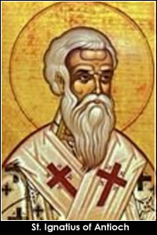
But it wasn’t long before some church leaders wanted to be bishops for power and wealth. Less than 100 years after James, St. Ignatius, Bishop of Antioch, started claiming that "we ought to regard the bishop as the Lord himself"
[25]

Slide 46
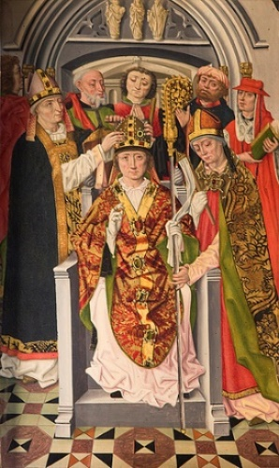
This is a medieval painting showing Bishop Nicholas of Myra in A.D. 311, being treated as a king.
(We know him as St. Nicholas, or Santa Claus.)
[26]
Notes:
http://www.stnicholascenter.org/pages/bishop-of-myra/

Slide 47
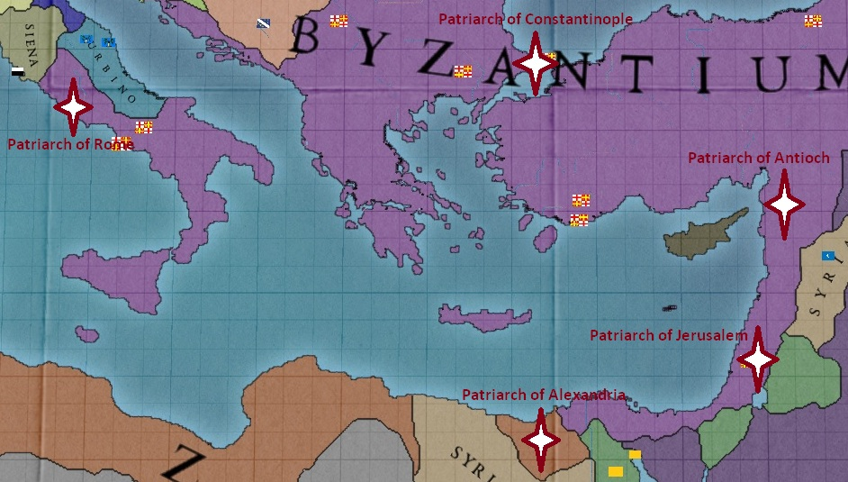
Within 400 years after James five different bishops called themselves patriarchs, and all claimed to be head of the church.
Mediterranean Sea

Slide 48
The power of the real Roman Empire was in ashes.
But the bishop in Rome established himself as the chief Patriarch, and as the Father of the Holy Roman Empire, saying that he had received permission from St. Peter, Christ’s disciple.
The pope claimed he had the power to save or condemn any person anywhere.

Slide 49
Today the pope still lives in Rome; in the Vatican City.
Mediterranean Sea

Slide 50
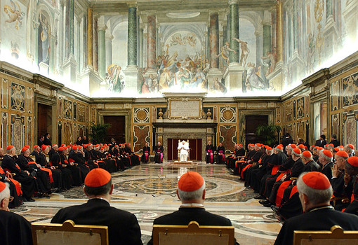
The Vatican, or Vatican City is a separate country in Rome. Yes, it is a country inside a city. The head of the Vatican is the pope. If you are a faithful Catholic you want to visit the “Holy City” of Rome and the Vatican.
The only people who live in the Vatican are the clergy of the church.
The paintings are by Michelangelo, a great artist who lived at the same time as Martin Luther.
[27]

Slide 51
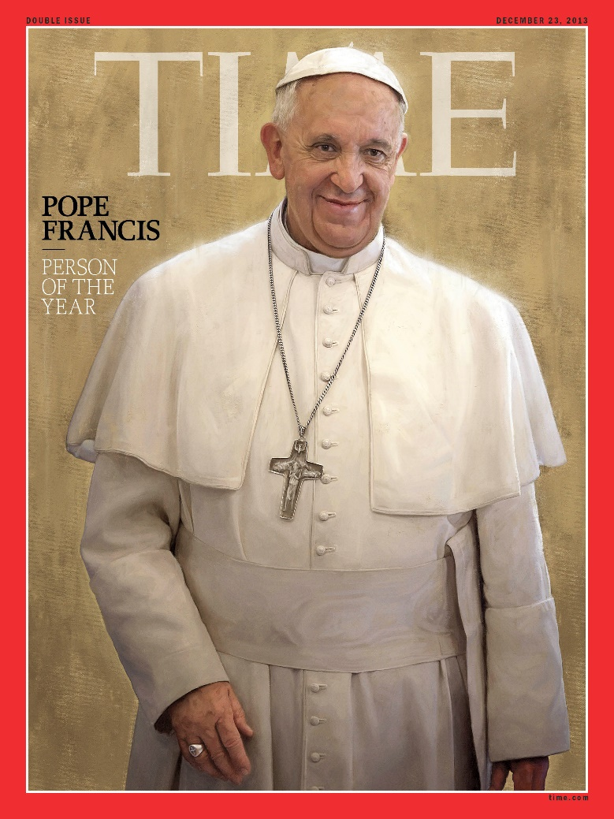
The pope in Rome has more riches and power than many countries. For 1600 years, gifts have been made to him from his followers, all seeking his favor.
Over that time span, there have been approximately 265 popes.
Today’s Pope Francis.
[28]

Slide 52
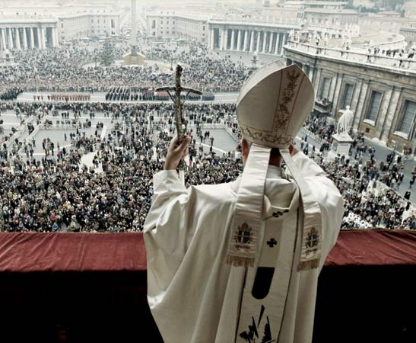
On special days the pope speaks to his followers in Rome.
[29]

Slide 53
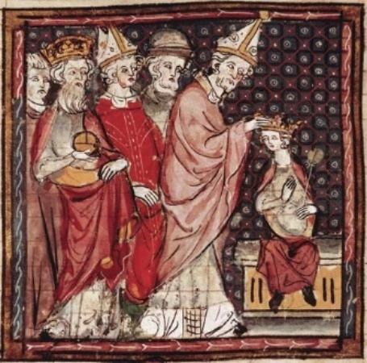
Today he no longer has power over governments, but during Luther’s life he claimed to be superior over every nation’s king (or emperor) and over all the lords, barons, and peasants.
If a country’s ruler did not obey the pope he was often replaced with an obedient Roman Catholic. His people were told by the church to disobey the king.
[30]

Slide 54
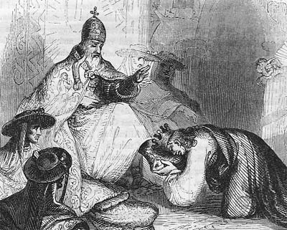
[31]
In this Medieval drawing Emperor Constantine is shown kissing the feet of the pope.

Slide 55
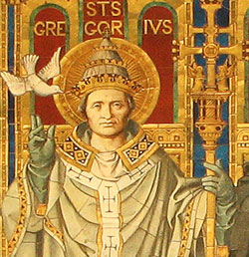
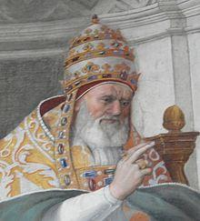
400 years before Luther this is what the popes said.
Pope Gregory VII in A.D. 1100 wrote:
“The Pope cannot be judged by any other human being.”
“The Roman Church has never erred and never will.”
Pope Gregory IX in A.D. 1227 claimed:
“I am Lord and Master of the whole Universe.”
[32]
[33]

Slide 56
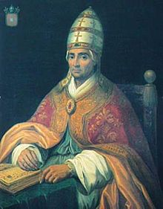
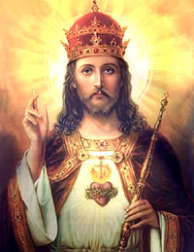
150 years before Luther, Pope Benedict XII said,
“All my power was given to me by God.”
A painting from the Middle Ages of Jesus wearing the pope’s crown.

Slide 57
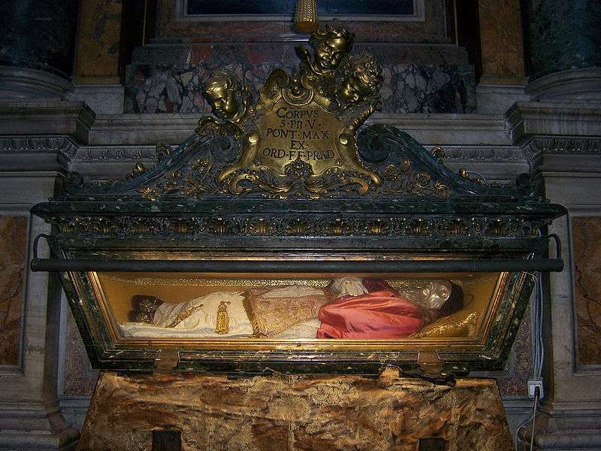
20 years after Luther’s death (1566), Pope Pius V, whose tomb is at the Vatican, said,
“What these popes have said is now eternal law.”

Slide 58
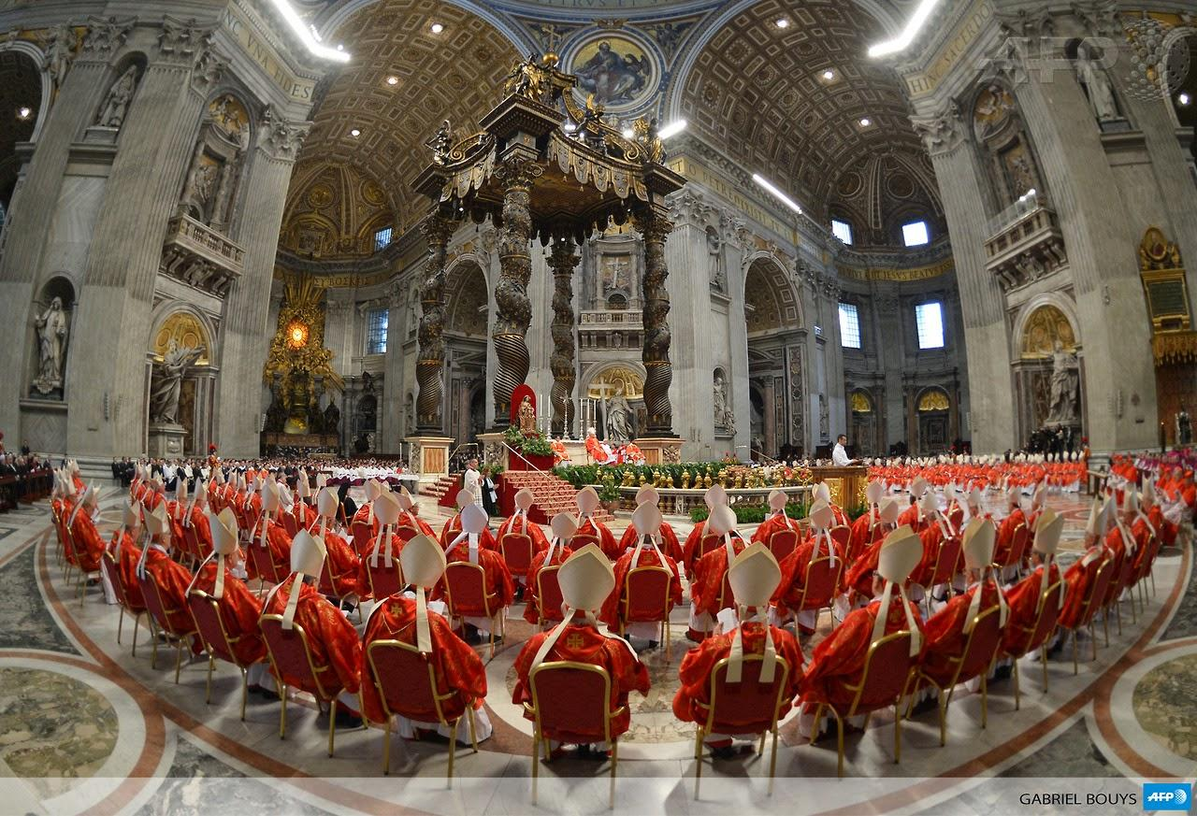
“The Church” was more interested in promoting the pope and its church system than preaching God’s Word which teaches about Jesus and forgiveness of sins and salvation in Him.
[34]
Notes:
http://www.sfx.com.my/index.php/sacraments

Slide 59
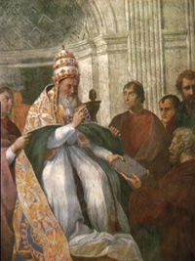
The pope’s church system conducted spiritual rituals (called sacraments) and created a system of rules called Canon Law that all its followers were supposed to adhere to.
Those who violated Canon Law could be excommunicated (banished from the church). No membership meant no chance of being saved.
Pope Leo IX issuing Roman Catholic Canon Law, A.D. 1234

Slide 60
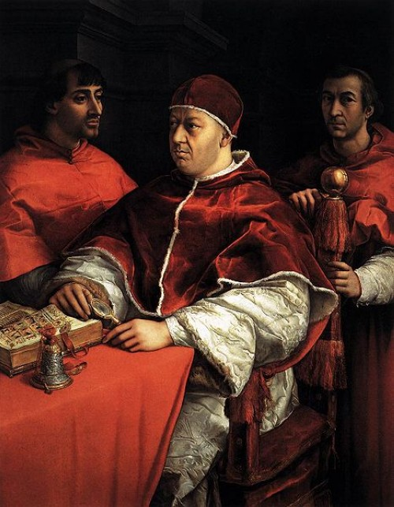
Kings or lords who followed the pope’s laws increased their power. Those who violated Canon Law could face interdiction, which meant that their country’s entire population would be banished from the church.
[35]
Pope Leo X who demanded that Luther, “this child of the devil,” be banished.

Slide 61
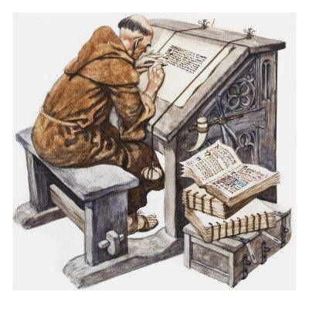
Now we begin to see what caused the Dark Ages.
Few people could read or write. Only the church had books or a Bible. Monks copied them by hand.
Life for the people was hard. The world was now very dangerous. Constant wars raged among neighboring kingdoms.
Roads were no longer safe. Goods were difficult to buy or sell.
A man’s castle needed high walls with moats, lookout towers and archers.
Farmland had to be hidden in the forest in separate parcels or worked next to a walled fortress. The church required a tithe, that is, 10% of everything the farmer produced.
[37]

Slide 62
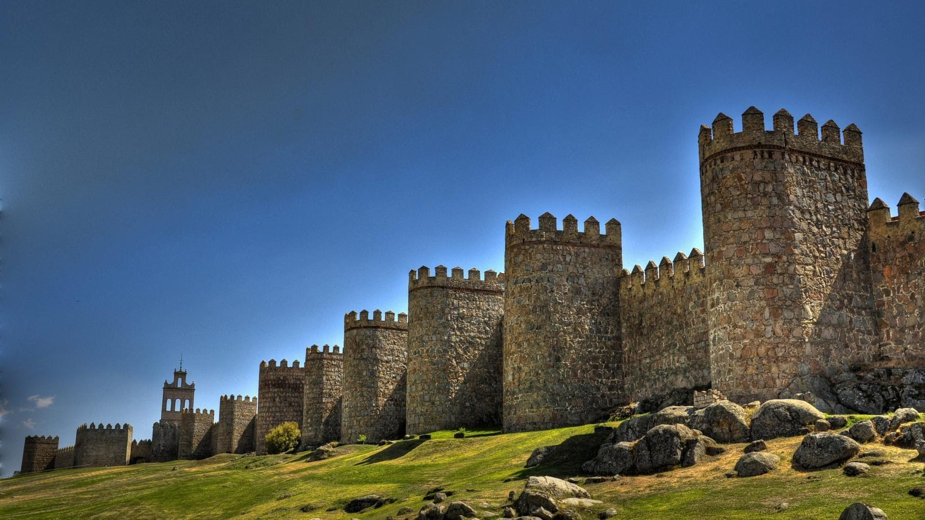
Most peasants left the ruined cities and worked all day growing food near a castle. The lord of the castle protected them and they fed his armies. If you were born to peasants here, you stayed here your whole life.
[36]

Slide 63

[41]

Slide 64
The Dark Ages was a time when the people were deceived by the popes and priests.
Ancient Mesopotamia 4000-333 B.C.
Ancient Greece 800-146 B.C.
4000 B.C.
2000 B.C.
A.D. 0
Today
Ancient Egypt 3081-30 B.C.
Rome 753 B.C. –A.D. 476
Ancient Israel 1700 B.C. – A.D. 70
The Dark Ages
Lies and superstitions were taught instead of the truths revealed in Scripture.
[38]

Slide 65

People were falsely taught that after death they would spend thousands of years in between heaven and earth, in a place called purgatory. Here they would work off the sins they committed in their lifetimes, unless a Roman Catholic priest granted them forgiveness.
[39]
Notes:
http://www.ourcatholicprayers.com/prayers-for-souls-in-purgatory.html

Slide 66

Peasants worked their whole lives on building the town cathedral with hand tools and stone. Each town wanted the biggest and best cathedral. If a builder died by falling off the scaffolding he was promised he could skip purgatory and go straight to heaven. Church members who gave money for the cathedral were promised shorter days or years of purgatory.
Domkirche St. Peter und Maria
[40]

Slide 67

The Latin Bible was the only Bible believers had during the Middle Ages.
But the people could not read it.
Only the church priests could read Latin.

Slide 68

So the priests told the people what the Bible supposedly said. They taught wrongly that Jesus was a fierce and angry judge. They taught the people to ask Mary to beg Jesus for forgiveness of their sins.
[42]
Notes:
http://www.catholicity.com/prayer/rosary.html

Slide 69

While Luther studied, Pope Leo X spent all the church’s money on his pleasures. In order to raise more money he published a piece of paper called an indulgence, claiming he needed money to complete the building of St. Peter’s Basilica in Rome. He paid priests to sell these pieces of paper to the people. Each indulgence was a guarantee of time off from purgatory for themselves or their dead loved ones (even though there is nothing in the Bible about a place called purgatory!).
[43]

Slide 70
At a lavish Good Friday banquet in the Vatican in 1514, and in the company of "seven intimates," Leo made an announcement that the Church has since tried hard to invalidate.
Raising a chalice of wine into the air, Pope Leo toasted: "How well we know what a profitable superstition this fable of Christ has been for us and our predecessors.“
(Annales Ecclesiastici, Caesar Baronius, Folio Antwerp, 1597, tome 14)
[44]

Slide 71

In 1483, during the reign of Pope Leo, Martin Luther was born in Germany to devout Christian parents. At age 23 he became a Roman Catholic priest; wanting to serve the Lord his whole life.
[45]
Luther enters the Cloister.

Slide 72

Luther spent three difficult years here, denying himself food, rest and comfort. As he tried to earn peace with God, he scrubbed cold stone floors, and wore rough clothing.
But he did not find the peace from sin that he sought. Many people were guilt-ridden by the false teachings of the Roman church.
[46]

Slide 73

He spent three years studying God’s Word in a Latin Bible translation because there was no German Bible translation. He learned both Greek and Hebrew , the original languages of the Old and New Testaments respectively. The bishop who was his master knew that Luther would one day be an important Bible teacher.
Luther became captive to the Word of God.
[47]

Slide 74

Luther writes that finding these words in Scripture was his most important breakthrough. The Gospel changed his conscience from being fearful to joyful.
Romans 1:16-17 For I am not ashamed of the gospel, for it is the power of God for salvation to everyone who believes, to the Jew first and also to the Greek. For in it the righteousness of God is revealed from faith to faith; as it is written, "BUT THE RIGHTEOUS man SHALL LIVE BY FAITH."
[48]

Slide 75
This discovery shocked Luther’s soul.
For hundreds of years the Roman church had been teaching that God would judge believers on the basis of their obedience to the pope’s church law. Souls would go to heaven, purgatory or hell, depending, supposedly, on what they did or didn’t do.
Remember, no one could look this up in the Bible. The schools did not teach the Gospel. The teachers, priests and monks did not read the Bible. Luther and everyone else went from grade school through University without ever studying God’s Word.
"BUT THE RIGHTEOUS man SHALL LIVE BY FAITH."

Slide 76

This is a painting of what medieval believers’ imaginations saw. Stefan Lochner, in A.D. 1435, painted this picture to show God the Judge. It showed that those who followed the pope were allowed into the doors of heaven. Those who did not were carried to purgatory or hell.
[49]

Slide 77
"The righteous person lives by faith."
Luther says, “All at once I felt that I had been born again and entered into paradise itself through open gates.
Immediately I saw the whole of Scripture in a different light.
Finally, after days and nights of wrestling with the difficulty, God had mercy on me and I was able to understand that the righteous person lives by the gift of God through faith alone.”

Slide 78

When Pope Leo sent men out to sell his indulgences Martin Luther protested. He wrote 95 theses (statements) on a poster and nailed it to the church door to start a discussion.
But what started was a Firestorm.
October 31, 1517

Slide 79

Miraculously, in 1454, Johannes Gutenberg had just finished inventing the printing press!

Slide 80

Movable Type
With this “most important invention in the world,” publishers could set up their words once and produce many copies of the same words within a few hours!

Slide 81

Luther’s 95 Theses were immediately printed and spread across Germany and then Europe. Many people agreed with this monk.

Slide 82

"I do not know,” wrote Luther, “whether the Christian faith can bear it, that there should be any other head of the universal church on earth than Christ himself".

Slide 83
He then wrote three powerful treatises that we can call his “Declarations of Independence.”
Note - These are the strongest of Lutheran documents, papers uncovering the fundamental errors of the Church of Rome, and able to fill us with firm confidence in our Mighty Fortress, our Savior - God.

Slide 84
Treatise Number 1, August, 1520
1. Address to the Christian Nobility of the German Nation Concerning the Reform of the Christian Estate.
“The Romanists, like all of us, are subject to the temporal sword; they have no power to interpret the Scriptures by mere authority, without learning; they have no authority to prevent a council or, in sheer wantonness, to pledge it, bind it, or take away its liberty; but if they do this, they are in truth the communion of Antichrist and of the devil, and have nothing at all of Christ except the name.”

Slide 85
Treatise Number 2, October, 1520
2. On the Babylonian Captivity of the Church.
This writing of Luther, the Reformer, attacks the whole heart of the papal system, its sacraments. It describes the error in the seven Sacraments of the Roman church; how five of them are invented outside Scripture and how the remaining two have diminished the grace given freely in the Sacrament of Baptism, and the Lord’s Supper.

Slide 86
Treatise Number 3, November, 1520
3. Treatise on Christian Liberty
“A Christian through faith is a free lord of all things and subject to none.”
“A Christian through love is the free servant of all things and subject to all.”

Slide 87
The German people stopped buying any more of the pope’s papers. The messenger who reported this to the pope warned him, “It would take an army of 25,000 soldiers to bring Luther here out of Germany.”
The pope wrote a command to Luther, “You shall repent of every word you said against the Roman Church. If you do not repent, you shall be punished as a heretic and burned at the stake.”
The command was delivered to Luther in Germany. He declared, “It is the pope who needs to repent.”

Slide 88

Then the German people gathered around him as he made a fire in the street and threw the pope’s letter in it.
[50]

Slide 89

But Luther had already quit the Roman Church in his heart. He knew he had the Lord’s forgiveness. His commitment to reform was irrevocable.

Slide 90

For his rebellion he had to stand before The Emperor, the pope’s obedient ruler. When he was told his books would be burned, and he would lose his life, liberty and property unless he recanted he replied:
[51]

Slide 91

"Unless I am convinced by Scripture and plain reason - I do not accept the authority of the popes and councils, for they have contradicted each other - my conscience is captive to the Word of God. I cannot and I will not recant anything, for to go against conscience is neither right nor safe. God help me. Amen."

Slide 92

Now Luther’s very life was in danger. The Emperor had placed him under the “ban.” Now any citizen who found him could legally kill him. Luther was hidden in this castle called “The Wartburg,” disguised as a knight, for nearly a year. He kept busy by translating the original Hebrew and Greek of the Bible into German, the language of the people.
Wartburg Castle, Germany
[52]

Slide 93
He worked for 10 weeks without resting, finding it very challenging to turn Greek and Hebrew words and ideas into German words.
Sometimes it took up to four weeks for him to search out the right German word to say what the Scriptures meant.
To compose the New Testament in German in only 10 weeks is amazing. Psychologists have measured Luther’s intelligence by analyzing what he wrote.
They list anyone with an Intelligence Quota (IQ) over 145 as a genius.
Napoleon 145 IQ
Ben Franklin 165 IQ
Martin Luther 170 IQ
Isaac Newton 190 IQ
God gave Luther every blessing to complete this mighty battle. His Bible translation is still highly prized today.

Slide 94


While Luther was in hiding, the Lutheran Reformers spread the news of Full and Free Salvation through Jesus very quickly. Many priests came from other countries to learn from Luther, and took his Bible teachings back to their own countries.

Slide 95
Europeans waited continually for more from Luther, and he worked tirelessly.
In 1529, after finishing the translation of the New Testament from Greek into German, the language of the people, Luther wrote the Small and Large Catechisms. He wanted parents to have a handy guidebook to instruct children in the six chief parts of Bible doctrine (teaching):
1. The Ten Commandments
2. The Apostles' Creed
3. The Lord’s Prayer
4. The Sacrament of Holy Baptism
5. The Ministry of the Keys & Confession
6. The Sacrament of the Lord’s Supper

Slide 96
In 1534 he finished and published the entire Bible in German, having started the Old Testament with the seven penitential psalms.
Even though these books were deemed illegal by the Roman church, people bought them as quickly as they were printed, and soon began debating with priests and monks in the streets.
The schools began producing students who were able to advance the study of Scripture. With the Holy Spirit working through the Word, the Gospel about Jesus as our Savior again began to flourish!

Slide 97

Lutherbibel in der Historischen Bibliothek der Franckeschen Stiftungen
(Luther‘s Bible in the Library of Franckes Foundation in Halle, Germany)
[53]
Almost 500 years old

Slide 98

2 Timothy 3:16 “All Scripture is God-breathed and is useful for teaching, rebuking, correcting and training in righteousness.”
Artist: Prof. Herman Fleischer, Northwestern College, Watertown, WI circa 1940. WELS Seminary library, Mequon, WI.

Slide 99

Luther married a former nun, Catherine von Bora, in 1525; God blessed them with six children. Philip Melanchthon was a frequent visitor in their home.
[54]

Slide 100
From Luther’s pen we find clear instruction regarding God’s attitude toward marriage.
“Now the ones who recognize the estate of marriage are those who firmly believe that God himself instituted it, … But the greatest good in married life, that which makes all suffering and labor worthwhile, is that God grants offspring and commands that they be brought up to worship and serve him.
In all the world this is the noblest and most precious work, because to God there can be nothing dearer than the salvation of souls. Now since we are all duty bound to suffer death, if need be, that we might bring a single soul to God, you can see how rich the estate of marriage is in good works…. Most certainly father and mother are apostles, bishops, and priests to their children, for it is they who make them acquainted with the gospel.
In short, there is no greater or nobler authority on earth than that of parents over their children, for this authority is both spiritual and temporal. Whoever teaches the gospel to another is truly his apostle and bishop… See therefore how good and great is God’s work and ordinance!”

Slide 101

Luther's Explanation to the Second Article of the Apostles’ Creed is a wonderful summary of the gospel of Jesus.
As the head of the family should teach it in a simple way to his household
.
I believe that Jesus Christ, true God, begotten of the Father from eternity, and also true man, born of the virgin Mary, is my Lord.
He has redeemed me, a lost and condemned person, purchased and won me from all sin, from death, and from the power of the devil, not with gold or silver, but with His holy, precious blood and His innocent suffering and death.
He did this that I should be His very own, live under Him in His kingdom, and serve Him in eternal righteousness, innocence, and joy; just as He is risen from death, lives and reigns in eternity.
This is most certainly true.
Notes:
http://www.immanuelmankato.org/discover/documents/luthers-small-catechism/apostles%E2%80%99-creed#overlay-context=USER

Slide 102
Confessions of the Lutheran Church still in use today:
The Apostles’ Creed
The Nicene Creed (A.D. 325)
The Athanasian Creed (A.D. 450)
Luther’s Small Catechism (A.D. 1529)
Luther’s Large Catechism (A.D 1529)
The Augsburg Confession (A.D. 1530)
The Apology (A.D 1530)
The Smalcald Articles (A.D 1537)
The Formula of Concord (A.D 1577)

Slide 103
Luther came to be known as the “Wittenberg Nightingale.” We have him to thank for being able to raise our voices in praise during worship.
Each Sunday, as new Lutheran congregations gathered to worship, they raised their voices in song. However, there were very few hymns at that time, as singing in the church had always been done by the clergy, and in Latin. Luther saw the great desire of the people to come “One and All, Rejoice.” He composed a hymnbook in German, many of which have been translated into our English language. Up next is his famous “hymn of the Reformation.”

Slide 104



Ein’ Feste Burg
A Mighty Fortress is our God!
About the performers
The Lutheran Quartet is made of up of four siblings:
Ann Radcliffe, soprano
Gail Richardson, alto
Rev. Bruce Naumann, tenor Rev. Paul Naumann, bass
[57]

Slide 105
In 1543 Luther also published this hymn as “a children’s hymn to be sung against the arch-enemies of Christ and His Church”
Lord, keep us steadfast in Thy word,
Curb Pope and Turk, and all that horde,
Who fain would hurl from off Thy throne
Christ Jesus, Thy beloved Son.
Lord Jesus Christ, Thy power make known;
For Thou art Lord of lords alone;
Defend Thy Christendom, that we
May evermore sing praise to Thee.
O Comforter of priceless worth,
Send peace and unity on earth;
Support us in our final strife,
And lead us out of death to life.

Slide 106

Martin Luther pointed the church back to the Savior in everything he preached and wrote and sang.
[55]

Slide 107
How blest we Lutherans are to be his heirs!
[56]

Slide 108
Footnote
One hundred years after Luther, philosopher Thomas Hobbes, whose ideas contributed to the American Declaration of Independence said, “The Papacy is not other than the Ghost of the deceased Roman Empire, sitting crowned upon the grave thereof. ”
Thomas Hobbes (1588-1679), Leviathan
Authors
Kathryn Ubl, CLC, Austin, Minnesota
Editor: Rev. Paul Fleischer, CLC, retired, Red Wing, Minnesota
September, 2016

Slide 109
Works Cited
1 Garden of Eden. Image. Answersingenesis.org. 15 May 2016. back
2 Canaan. Map. Estudio Biblia. Web. 26 Apr 2015 back
3 Bogae, Martin van den. Luther. Photo. 15 Mar 2016. back
4 Luther. Image. Photocopy of German postcard. Circa 1940. back
5 Cranach, Lucas. Luther. Painting. 15 Mar 2016. back
6 Advanced Bible History in the words of Holy Scripture. St. Louis: Concordia Publishing House, 1936. back
7 Mesopotamia. History.com. Web. 15 February 2015. back

Slide 110
8 History.com Web. 15 February 2015 back
Polack, W.G. The story of Luther. St. Louis: Concordia Publishing House, 1941. back
Grun, Bernard. The timetables of history : a horizontal linkage of people and events, based on Werner Stein's Kulturfahrplan. New York : Simon and Schuster, c1991. back
When Was Jesus Born? Herod’s Death, Jesus’ Birth and a Lunar Eclipse Web. 3 Mar 2015. back
The Church through the ages. St. Louis: Concordia Publishing House, 1963. back
Roman Legions. Image. The Battle of Cynoscephalae. 15 May 2016. back
Roman army. Image. Total War Center. 15 Mar 2016. back
Portchester in Roman times. Image. BBC – Schools – Primary History. 15 Mar 2016. back

Slide 111
16 Rome. Image. Illustrated History of the Roman Empire. 16 Mar 2015. back
17 Roman roads. Map. Beautiful network of ancient Roman roads. 18 Feb 2016. back
18 Paul’s journeys. Map. Christian Bible Tours. 20 Feb 2016. back
19 Juta, Jason. Roman Formation. Image. Militar.org.ua. 15 May 2016. back
20 Circus Maximus. Image. Socialstudiesforkids. 1 May 2016. back
21 Odoacer. Image. Lo Que Pasó en la Historia. 1 May 2016. back
Roman Forum via Free Wallpapers 1 May 2016. back
Tissot, James. The Reconstruction of Jerusalem and the Temple of Herod. Photograph. Tisha B'Av: The Temple . 19 Mar 2016 back

Slide 112
Halley, Henry H. Halley’s Bible Handbook. Grand Rapids: Zondervan, 1965. back
Ignatius. The Epistle of Ignatius to the Ephesians. Web. 1 Mar 2016. back
St. Nicholas invested as bishop. Image. Fr. Lawrence Lew, O.P. via Flickr. 1 Mar 2016. back
Synod of 1987 via Parish Pastoral Councils 19 Mar. 2016. back
Time Magazine. 2013 Person of the Year: Pope Francis, the people’s Pope . Image. 1 Mar 2016. back
pope. Photograph. Britannica Online for Kids. Web. 19 Mar 2016. back

Slide 113
30 The Coronation of Ludwig Image by Wikimedia Commons. 1 Mar 2016. back
31 Kissing the pope’s feet. Image. Foxe’s Book of Martyrs. Web. 20 Mar 2016. back
32 Raphael, Detail from fresco of Pope Gregory IX approving the Decretals, 1511, Fresco Stanza della Segnatura, Palazzi Pontifici, Vatican, Vatican City State via Wikimedia Commons 15 May 2016 back
33 "Audacious Papal Claims: The Pope as Christ." True Orthodox Christianity. 2005. Web. 15 May 2016. back
34 The World’s Largest Church (Vatican) by UFOmania via Flickr. 1 Mar 2016. back

Slide 114
35 Pavao, Paul F. Martin Luther. Christian History for Everyman. 2016. Web 1 May 2016. back
36 Fortress walls. Image. High Quality Wallpapers Online. 1 Mar 2016. back
37 Trueman, C.N. "The Lifestyle Of Medieval Peasants" The History Learning Site, 5 Mar 2015. 3 Mar 2016. back
38 Pennington, Kenneth. A Short History of Canon Law from Apostolic Times to 1917. Web. 1 Mar 2016. back
39 Prayers for souls in Purgatory. Ourcatholicprayers.com. 1 Mar 2016. back
Trueman, C.N. "The Medieval Church.“ Web. The History Learning Site 5 Mar 2015. 3 Mar 2016. back
Medieval farming. Via OpenClipart. Image. 1 Mar 2016. back

Slide 115
42 A Beginner's Guide to the Rosary. CatholicCity.com Web. 1 Mar 2016. back
43 Bainton, Roland H. Here I Stand. New York: Mentor, 1950. back
44 Pope Leo X And His Most Infamous Declaration About Christianity. 27 Dec 2009. Web Forum. 15 May 2016. back
45 Bainton, Roland H. Here I Stand. New York: Mentor, 1950. back
46 Dowling, Mike. Flagellants. Image. "The Black Death at mrdowling.com". Updated July 31, 2015. Web. 20 Mar 2016. back
47 Polack, W.G. The story of Luther. St. Louis: Concordia Publishing House, 1941. back
48 "Selected Works of Martin Luther." Project Wittenberg, Last modified 26 Oct. 2004. Web. 15 May 2016. back

Slide 116
49 Lochner, Stephen. “The Last Judgment.” Painting. Via Wikimedia Commons. 1 Mar 2016 back
Luther burning the papal bull. Image. The trial of Martin Luther. 1 Mar 2016. back
Luther answering charges of heresy before the Diet of Worms in 1521. back
The Wartburg Castle. Image. Via Wikimedia Commons. 1 Mar 2016. back
Original Luther Bible. Image. Die Franckeschen Stiftungen Zu Halle. 1 Mar 2016. back
Spangenberg, G.A. Martin Luther and his family. Image. Via Musee de Leipzig. 1866. 19 Mar 2016. back

Slide 117
Cranach, Lucas. A picture of true preaching. Image. Via Apostolic Theology. 1 May 2016. back
Martin Luther’s seal. Image. 1 May 2016. back
A Mighty Fortress (Ein feste Burg ist unser Gott) (arr. J. Rutter): John Scott, The Cambridge Singers, John Rutter & City of London Sinfonia Album: Sing, Ye Heavens - Hymns for All Time back
Additional website of interest, as Luther actually influenced our American spirit. The Bible and Government. Excerpt: “There had been times when the state had absolute authority and persecuted the church. At other times the church had effective control of the state. The founders saw that neither of these extremes were ideal. They developed a system that stood the test of time. Observers everywhere generally agree that American's Founding Fathers achieved a solid balance between church and state, one consistent with biblical concepts.” http://www.faithfacts.org/christ-and-the-culture/the-bible-and-government

