Slide 1
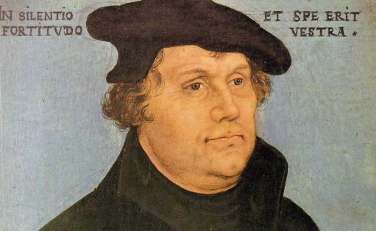
Who was Martin Luther?

Slide 2
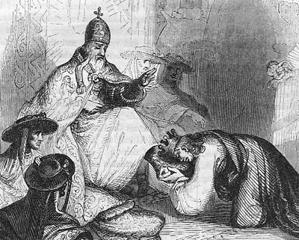
Martin Luther was a great pastor 500 years ago, during a time when the Pope, a very powerful man, told believers they must be very good to go to Heaven.
.
Notes:
Full text of Luther's documents. He did not capitalize the word pope. http://www.projectwittenberg.org/pub/resources/text/wittenberg/luther/web/nblty-03.html

Slide 3
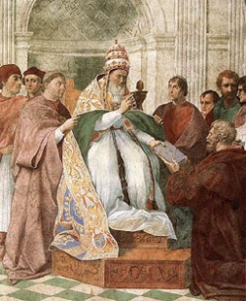
The head of the church, Pope Leo, was more powerful than the king. He said believers did not need to read the Bible because he and his priests were the ones who would tell them what the Bible taught.
Pope Leo also taught that it was impossible for a Pope to make an error.
Notes:
http://liturgia.mforos.com/1699131/10523877-proclamacion-de-dogmas/

Slide 4
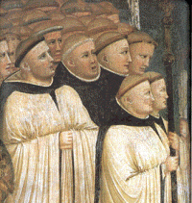
Martin wanted to be good enough to go to Heaven. In 1505 he decided to become a monk so he could spend his life serving God. That meant he had to give away all his earthly goods and live the hard life of a poor man. He studied every day, all day to learn about God.
Monks

Slide 5
He and the other priests learned all about the laws made by the Church rulers: the Pope, Bishops, and Priests. These laws, written in Latin, gave the church the power to order and direct the activities of Catholic believers.
But monks did not have to read a Bible while they were learning to be pastors. They were taught to learn and obey the laws of the Catholic church, but were not taught from the Bible.

Slide 6
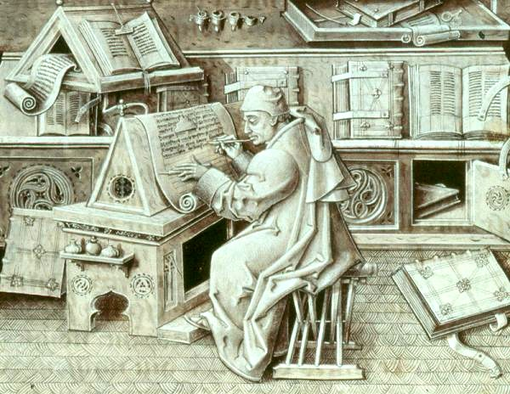
In Germany, at the time of Luther, no one had Bibles at home either, because they were too expensive. They had to be written out by hand. Some priests who lived in monasteries copied one Bible at a time, after they made the paper and pens and ink first. It took a very long time to make one Bible.

Slide 7
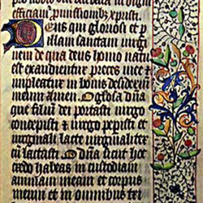
And when these priests made a Bible, they copied it in the Latin language, not the German language.
So people could not read the words in the church Bibles.
This is a picture of one page of a Latin Bible.

Slide 8
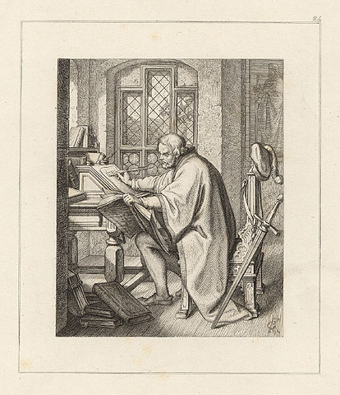
But Martin wanted to know what the Bible said he should do to be saved. He looked for a Bible and found one up in a tower. He began studying all over again. He wanted to know God’s plan for sinners.

Slide 9
The world says that mankind's worst problems are sickness, poverty, greed or unfairness.
But God says that mankind’s worst problem is SIN. He tells us about sin in His Word, the Holy Bible.

Slide 10
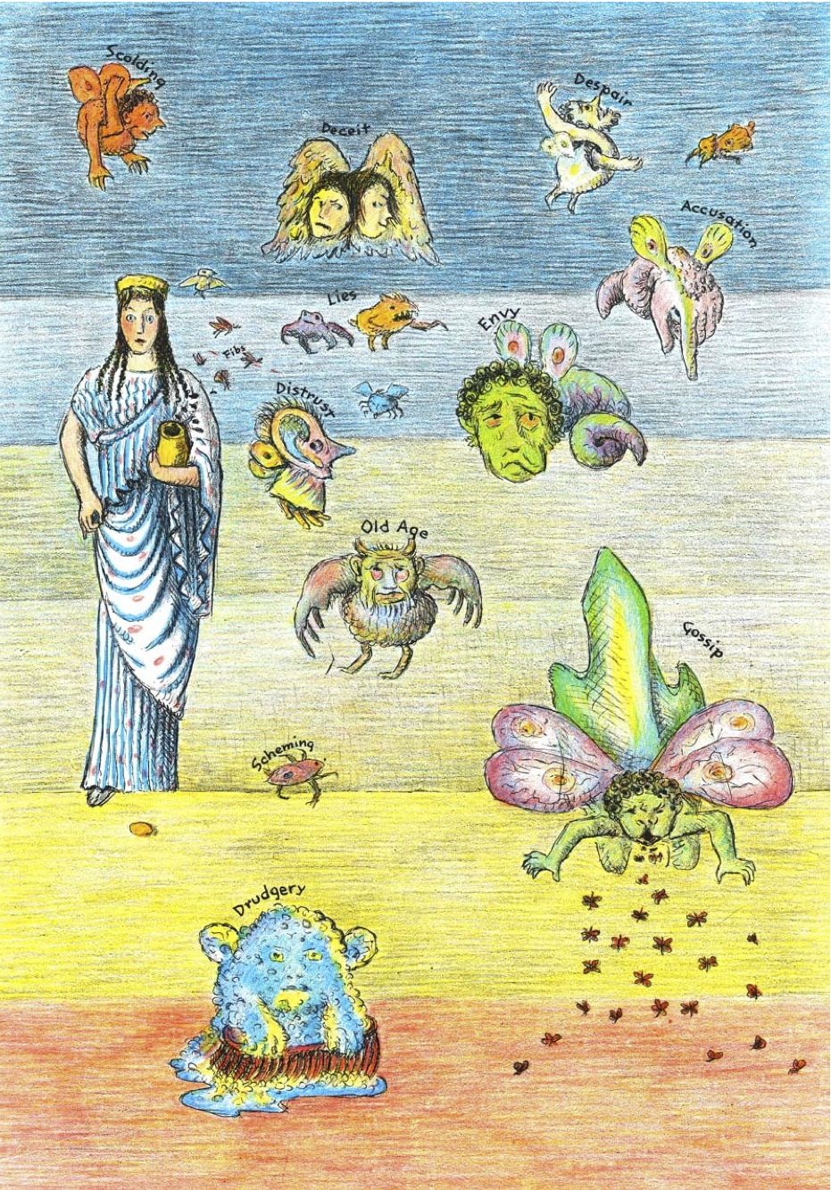
Here is a remarkable picture from D'Aulaires' Book of Greek Myths, c1962, of some of the problems that came after Adam and Eve sinned.
Can you think of an example of each one?
Notes:
http://somekingskent.blogspot.com/2012/12/the-art-of-daulaires-greek-myth.html

Slide 11
The Bible tells us that, in the beginning, God made everything perfect. But when Adam and Eve disobeyed God everything was ruined. Now we are born sinful. God’s Law says, “The wages of sin is death.” Romans 6:23

Slide 12
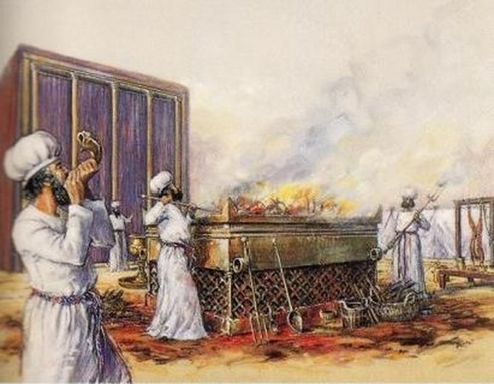
Throughout Old Testament times, God told His people to make burnt offerings as sacrifices to Him. He wanted them to remember that they were sinners and to understand that Jesus, their Savior, was coming to forgive all sins by dying on the cross and rising again.

Slide 13
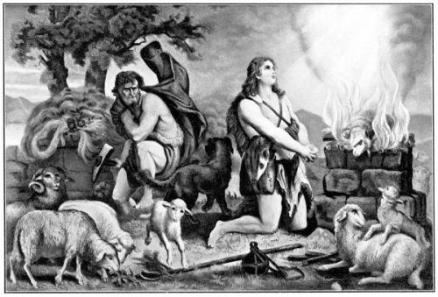
The Bible tells us that the first people who made sacrifices were Adam and Eve’s sons: Cain and Abel
Cain offered his best crops to God.
Able offered his most perfect animals to God

Slide 14
God accepted Abel’s offering for his sins because his offering came from his faith.
He did not accept Cain’s offering.
Martin Luther wanted to be like Abel.

Slide 15
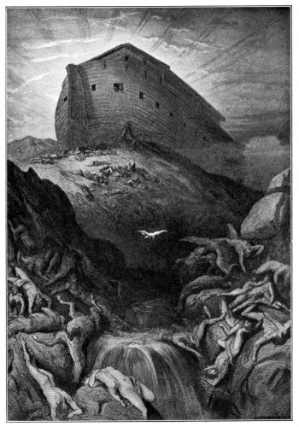
Later, when Noah and his family were brought safely through the Great Flood, Noah built an altar to the Lord so he could sacrifice like Adam and Abel and others before him.

Slide 16
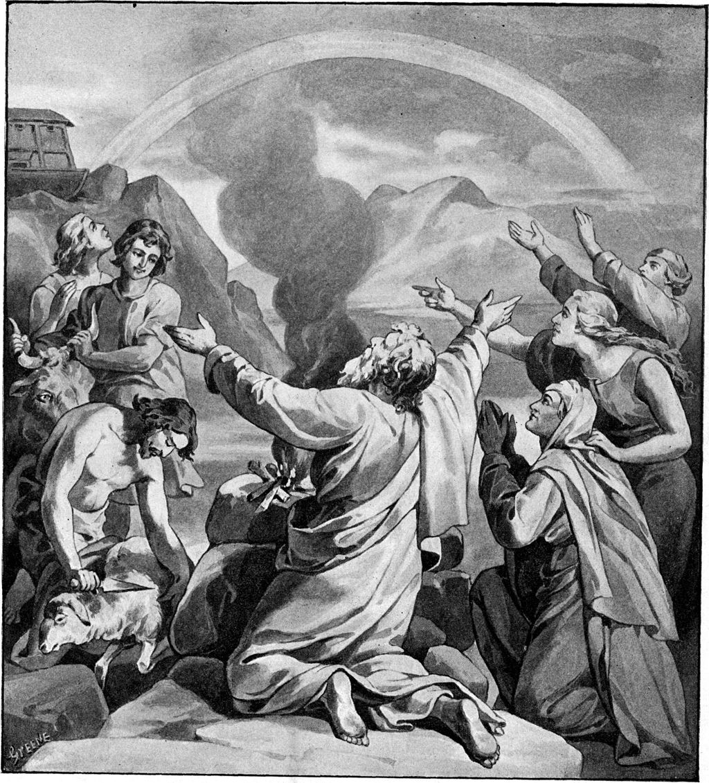
Noah placed his best animals on the altar to praise and thank God. Luther wanted to be like Noah by giving God praise and thanks.

Slide 17
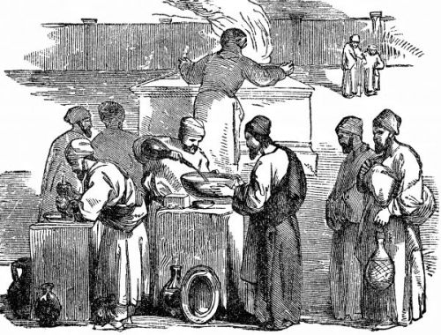
After Noah, God’s people continued to bring burnt offerings to His altar from the best of their fields and herds.
Notes:
http://www.hebroots.com/lul7_8.html

Slide 18
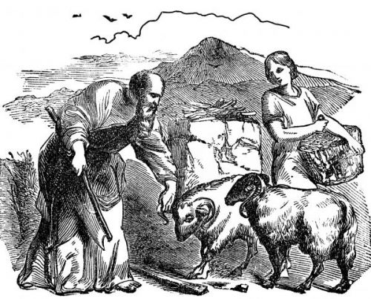
God told His people in Leviticus, “When a man offers a sacrifice to the LORD it must be perfect to be accepted; there shall be no defect in it. Those animals that are blind or broken or lame or having scabs, you shall not offer to the LORD..."
Why did God demand that these sacrifices be perfect?

Slide 19
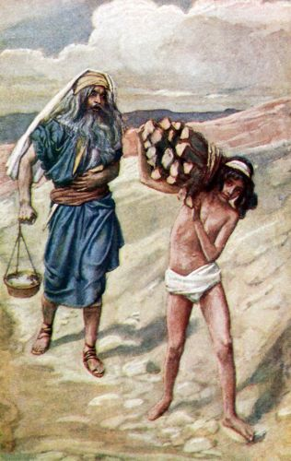
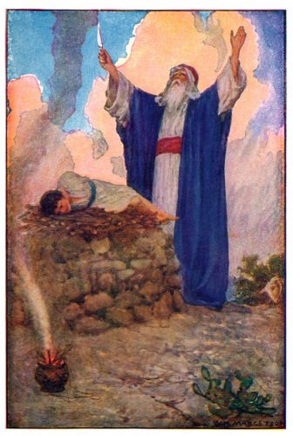
Later in Genesis, when God tested Abraham’s faith by asking him to sacrifice his only son on an altar, Abraham obeyed. Martin Luther wanted to be willing to give up everything like Abraham.

Slide 20
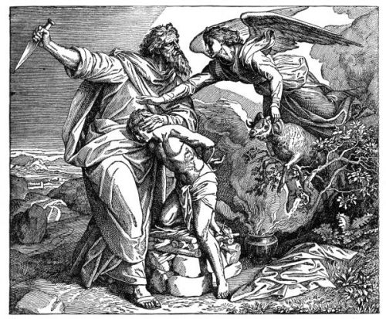
When God saw Abraham’s heart He sent an angel to bring a perfect ram for Abraham to sacrifice instead of his son Isaac.

Slide 21
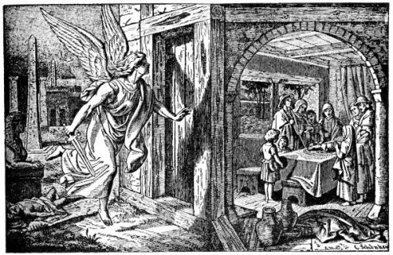
In Exodus, when the Angel of Death passed through Egypt, God’s children were saved by painting the blood of an innocent little lamb over their doors as God told them to. They believed God’s promise of a coming Savior. Martin Luther wanted to be obedient like the Children of Israel.

Slide 22
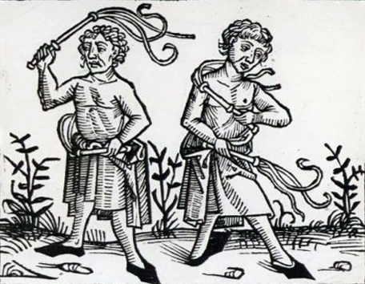
When Luther first became a monk he tried sacrificing to God.
He beat himself with a scourge until his back bled.
He sacrificed his food, warm clothes and soft bed.
But he did not feel satisfied that he was able to be good enough.
So he turned back to the Bible to see if there was another way.
What he found there was amazing.

Slide 23
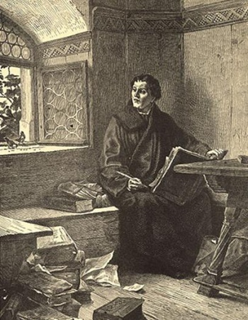
He read the Bible until he found St. Paul’s words about sin and grace, God's love for all people.
“By Faith you are saved!”

Slide 24
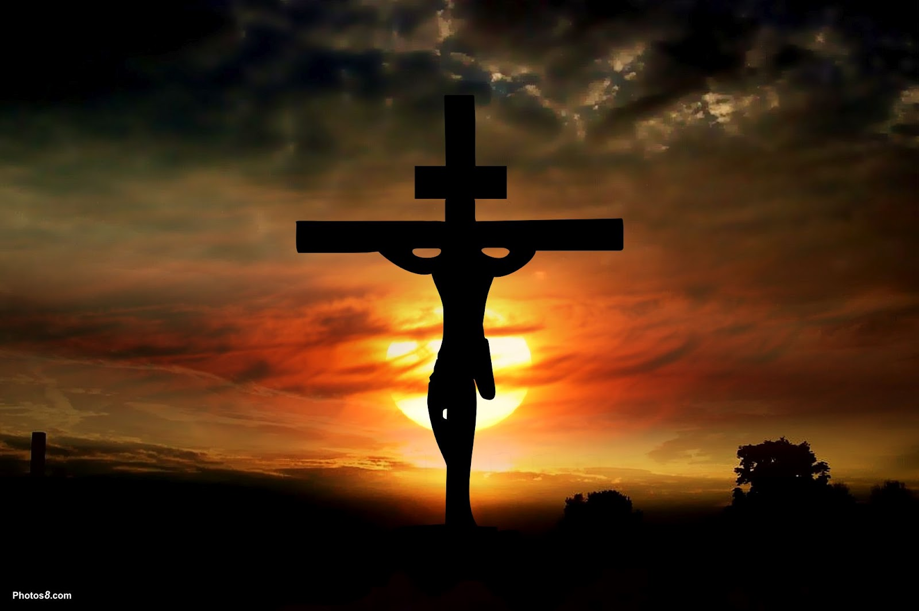
The Bible told Luther that he did not need to make sacrifices to pay for his sins. That had already been done by God. He did not wait for us to find our own way out of trouble. He provided the perfect sacrifice.

Slide 25
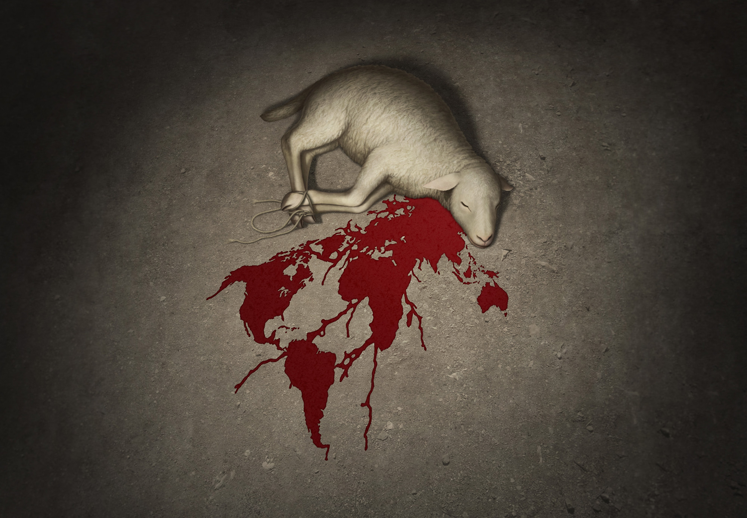
He sent His only Son, Jesus, to be the innocent lamb who would take our punishment.
Artist: Jonathan Mayer
Scapegoat Studio - Liturgical Art & Design

Slide 26
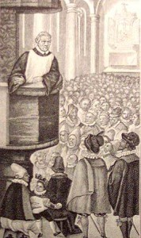
When Luther learned this he couldn't wait to tell the Good News. Every sermon from Luther told Christians that Jesus had paid for all their sins.
No one needed to follow the made-up rules of the Pope to pay for their sins.

Slide 27
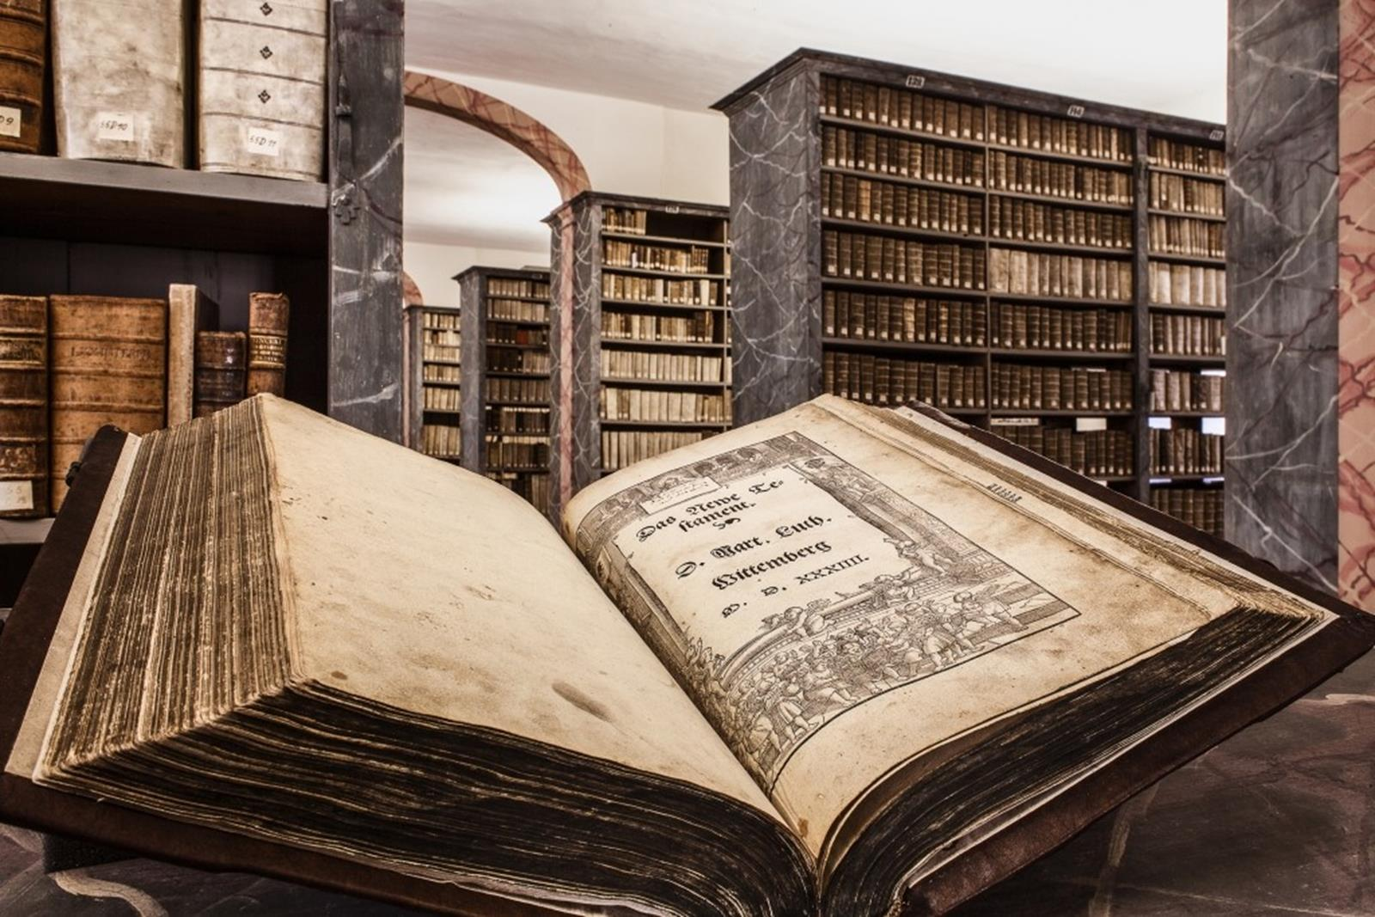
.
Luther spent a long time writing a Bible in the German language so that people could read it by themselves.
Someone saved this copy and put it safely in a German library. It is over 500 years old.

Slide 28
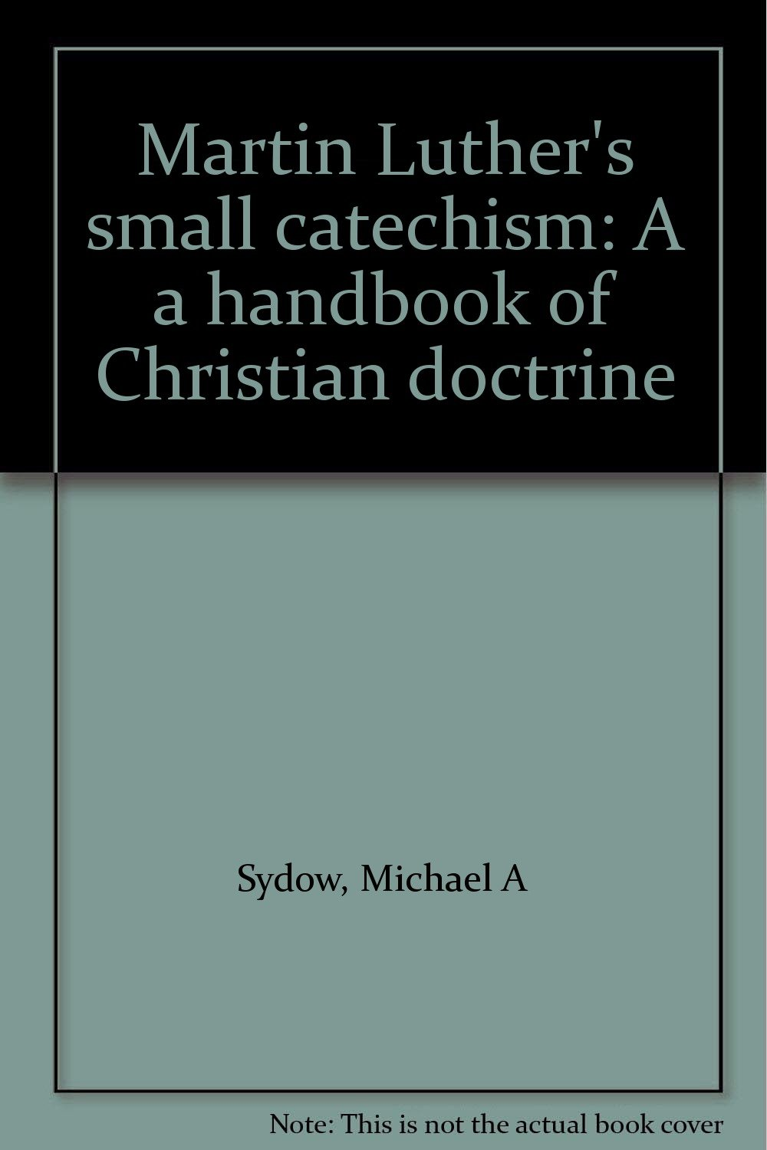
He also wrote catechisms for the teaching of the Bible to explain its most important messages.

Slide 29
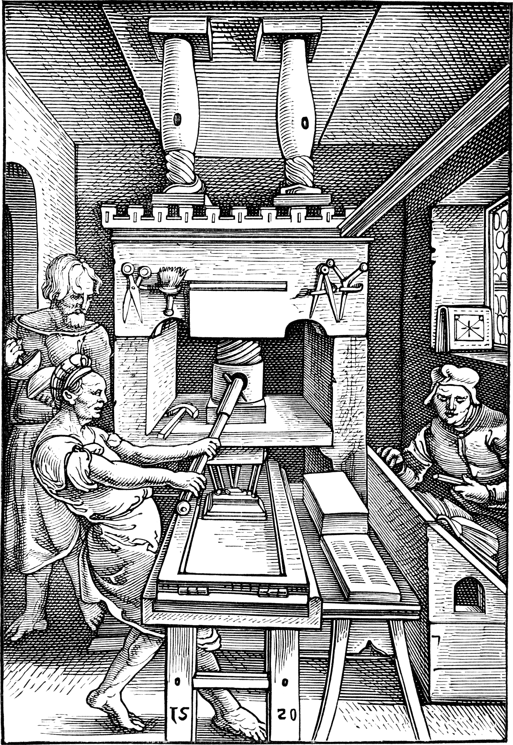
Miraculously, a little earlier, the printing press had been invented in Germany. After 4,500 years of copying words by hand, now books could be printed by machine! Almost everyone could afford to read a Bible or a catechism.​
​
​

Slide 30
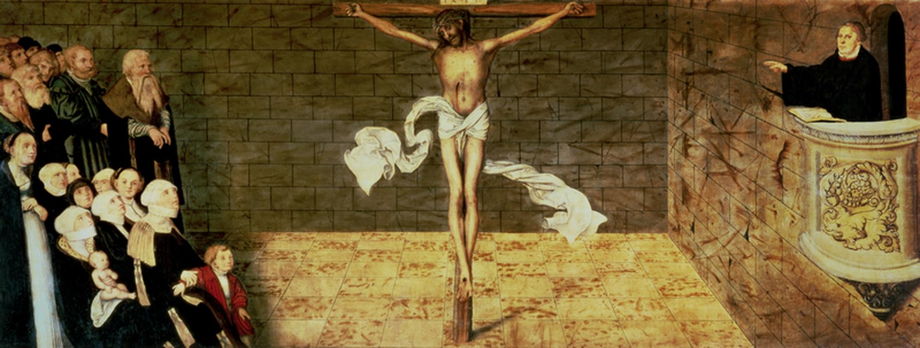
With these books, teachers began to teach about God in German schools. They used Luther's books and soon the people knew more about the Bible than the Pope and his priests did.​
Notes:
“I defie the Pope and all his lawes. If God spare my life, ere many yeares I wyl cause a boy that driveth the plough to know more of the Scripture, than he doust.” William Tyndale. https://en.wikiquote.org/wiki/William_Tyndale

Slide 31
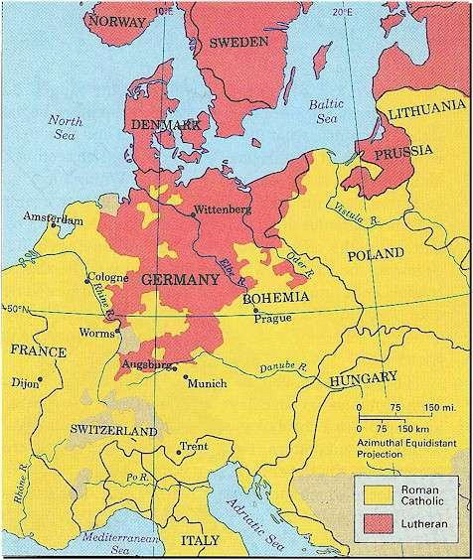
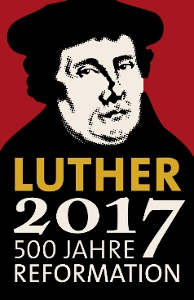
Luther’s books went out all over Germany, Denmark, Sweden, and Norway. Many believed the True Word of God that Luther found in the Bible. Priests from those countries came to Germany to learn from Luther. They carried their new knowledge back to their own congregations.

Slide 32
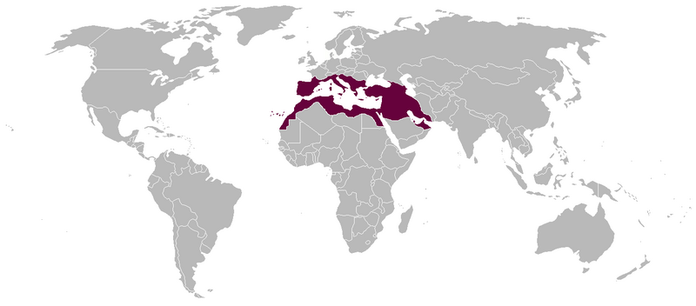
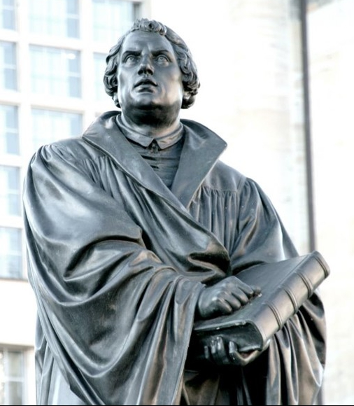
Then, Luther’s books and teachings came to America from Europe with the settlers.
European Lutherans brought their faith from the Old World
To the NEW World
Salvation by Scripture alone
Faith alone
Grace alone

Slide 33
We still follow his words today. We call ourselves Lutherans.
Luther’s seal – “For one who believes from the heart will be justified" (Romans 10:10)

Slide 34
The End
Written by Kathryn Ubl, member of our CLC congregation in Austin, Minnesota for the 500th Anniversary of the Lutheran Reformation. March, 2017.
Edited by Professor Ross Roehl, Immanuel Lutheran College, Eau Claire, WI
Images taken from Foster Bible Pictures at Wikimedia Commons

